Slide 1
NBAC TSC Slides 28 August 2025 Meeting
Stephen Sullivan

Slide 2
28 August 2025 NBAC TSC Agenda
1:00 NBAC Chair (s) Opening Remarks – Mr. Kamran Atri, Thomas Krul & Paul Wormeli
NBAC ZOOM meetings going forward
PGB electing new PGB Chair (s) this afternoon following NBAC meeting
Microsoft Teams
Join the meeting now
Meeting ID: 993 992 894 975
Passcode: Gs9YZ7DH
Dial in by phone
+1 410-874-6749,,878640958# United States, Odenton
Find a local number
Phone conference ID: 878 640 958#
Forensics Sub-Committee TOWNHALL scheduled for 9 October 2025, 2-3 PM EDT look for notice to join event
Short meeting today because PGB meets immediately afterwards
1:05 NIEM Management Office (NMO) Update – Mr. Steve Sullivan
NMO roles and responsibilities in transition
8 October Leadership Meeting @NPC
13 November Reveal Summit Webinar
1:10 NTAC Update – Scott Renner, Brad Bolliger
1:15 Communications & Outreach NMO Sub-Committee – Paul Wormeli
1:20 Questions/Final Remarks

Slide 3


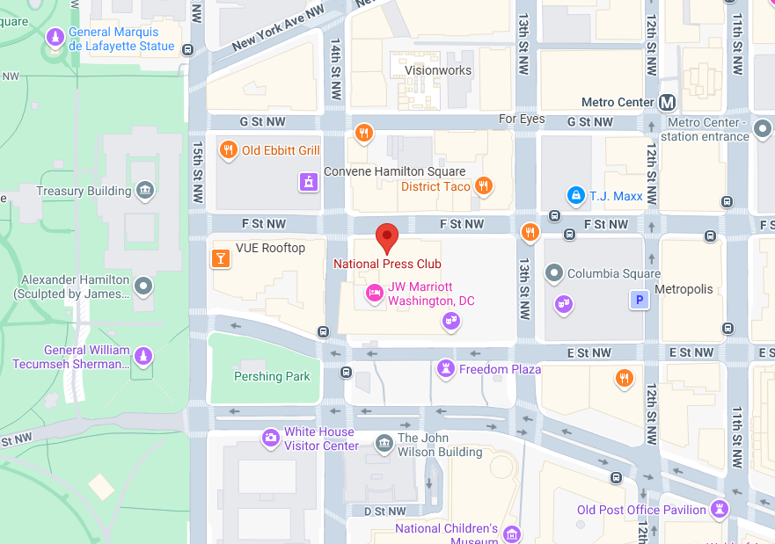
NIEMOpen Leadership Meeting National Press Club & Virtual
Date/time: 8 October 2025, ~ 9 AM – 4 PM
Venue: National Press Club & Virtual
529 14th St NW, Washington, DC 20045
“DRAFT” Agenda
Link for NBAC & NTAC Plenary Sessions: TBD
Link for AM & PM Joint Sessions & Q&A:
OASIS NIEM is inviting you to a scheduled Zoom meeting. Join Zoom Meeting https://us06web.zoom.us/j/8016452879?pwd=a3hNN0dieVJPR1pZY2QwbHVXbFJTUT09&omn=86251094933 Meeting ID: 801 645 2879 Passcode: 676136 One tap mobile +13052241968,,8016452879#,,,,*676136# US +13092053325,,8016452879#,,,,*676136# US
Supporting documents: https://github.com/niemopen/nbac-admin/tree/main/8-october-co-chair-meeting-npc

Slide 4
Reveal Summit Webinar
The IJIS Institute is hosting the virtual NIEMOpen Reveal Summit on November 13th , 2025 from 9AM to 4PM EST.
IJIS link for registration: NIEMOpen Reveal Summit Webinar
Supporting document repo:
https://github.com/niemopen/nbac-admin/tree/main/2025-reveal-summit
Ms. Teri Takai, a leader in information technologies and digital government, and Mr. Kshemendra Paul, first director of NIEM, have graciously agreed to keynote the event.
The Summit highlights use cases from the field where developers have adapted NIEM to solve contemporary information exchange problems.
While the final agenda is still a work in progress, several topic areas stand out:
Agenda Highlights “Strawman”
Keynotes: Teri Takai & Kshemendra Paul
Gust speaker: Information Sharing Standards: Dr. Kristen Honey (invited)
The New NIEM 6.0 & Tooling – Dr. Scott Renner
OASIS BOD Chair
JSON Demo – Brad Bolliger
Shaping NIEMOpen for the Future – Brad Bolliger
Voices from the Field – Ms. Maria Cardiellos
NIEMOpen Awards

